Slide 1
Executive Director's Report
2023-2025
Collective action for a resilient Caribbean sea
Agenda item 5.2
UNEP(DEPI)/CAR IG.49/INF.3

Slide 2
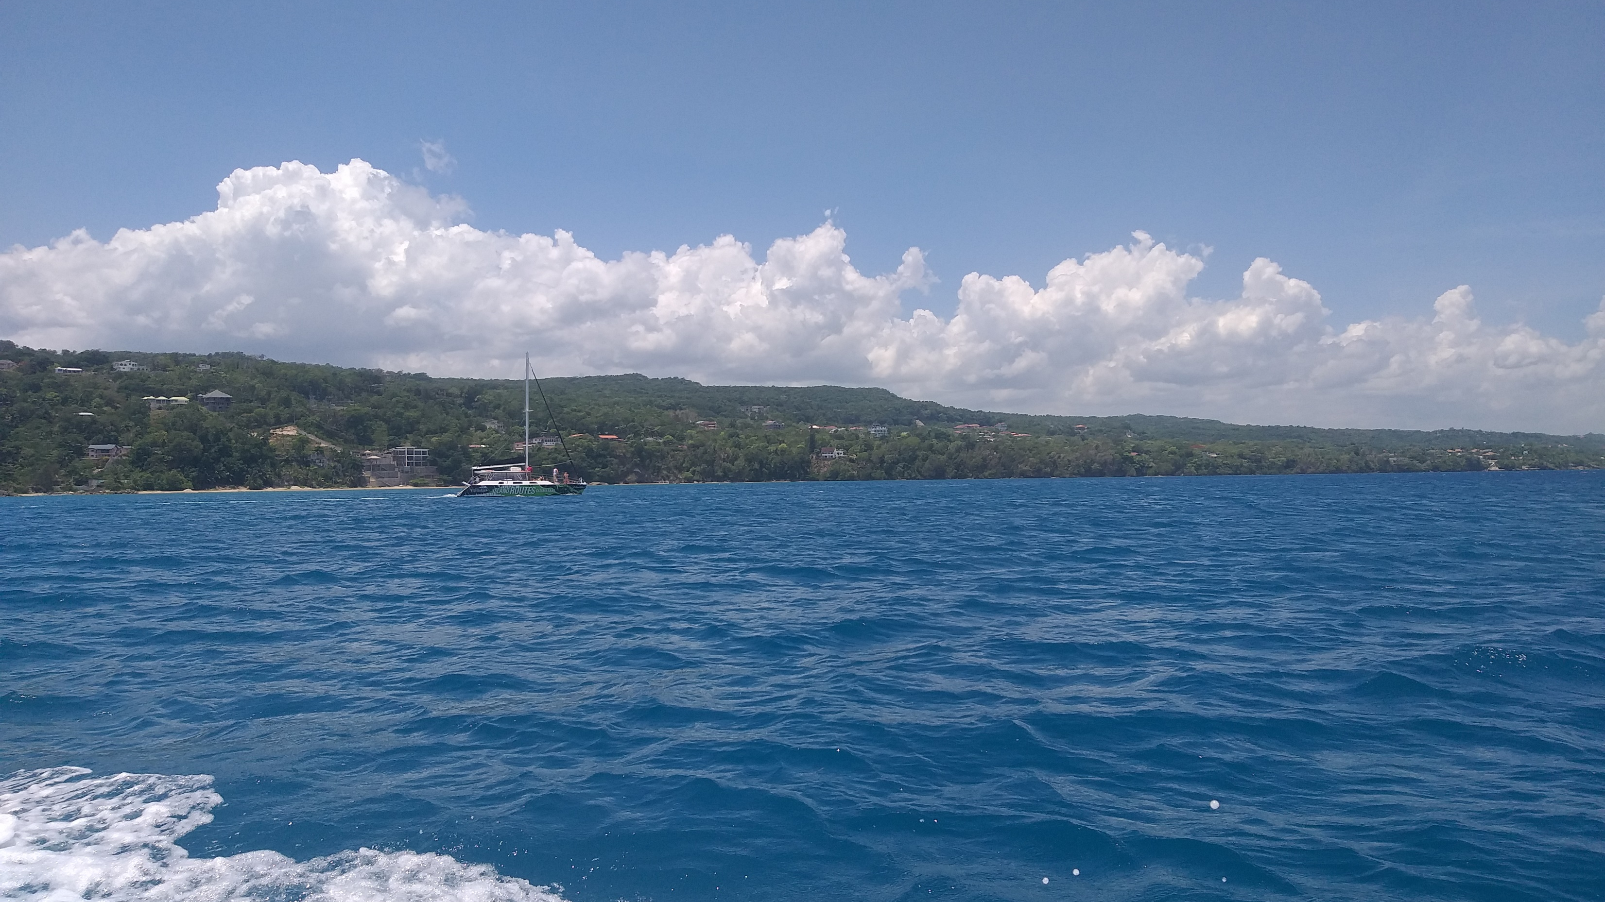
Part 1
The Big Picture
"Collective Action for a Resilient Caribbean Sea. "

Slide 3
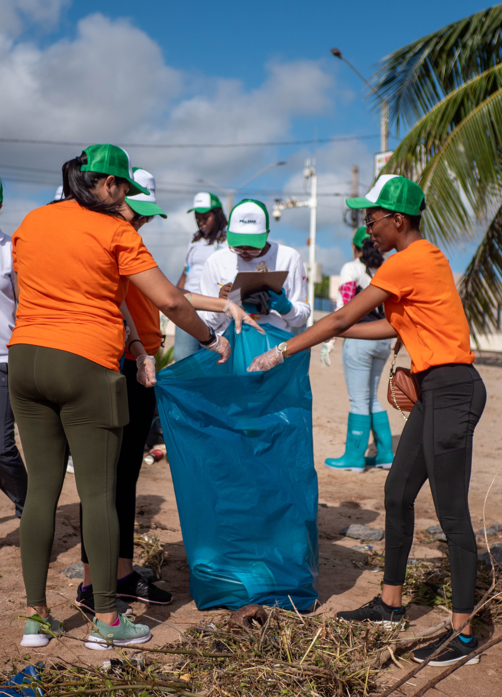
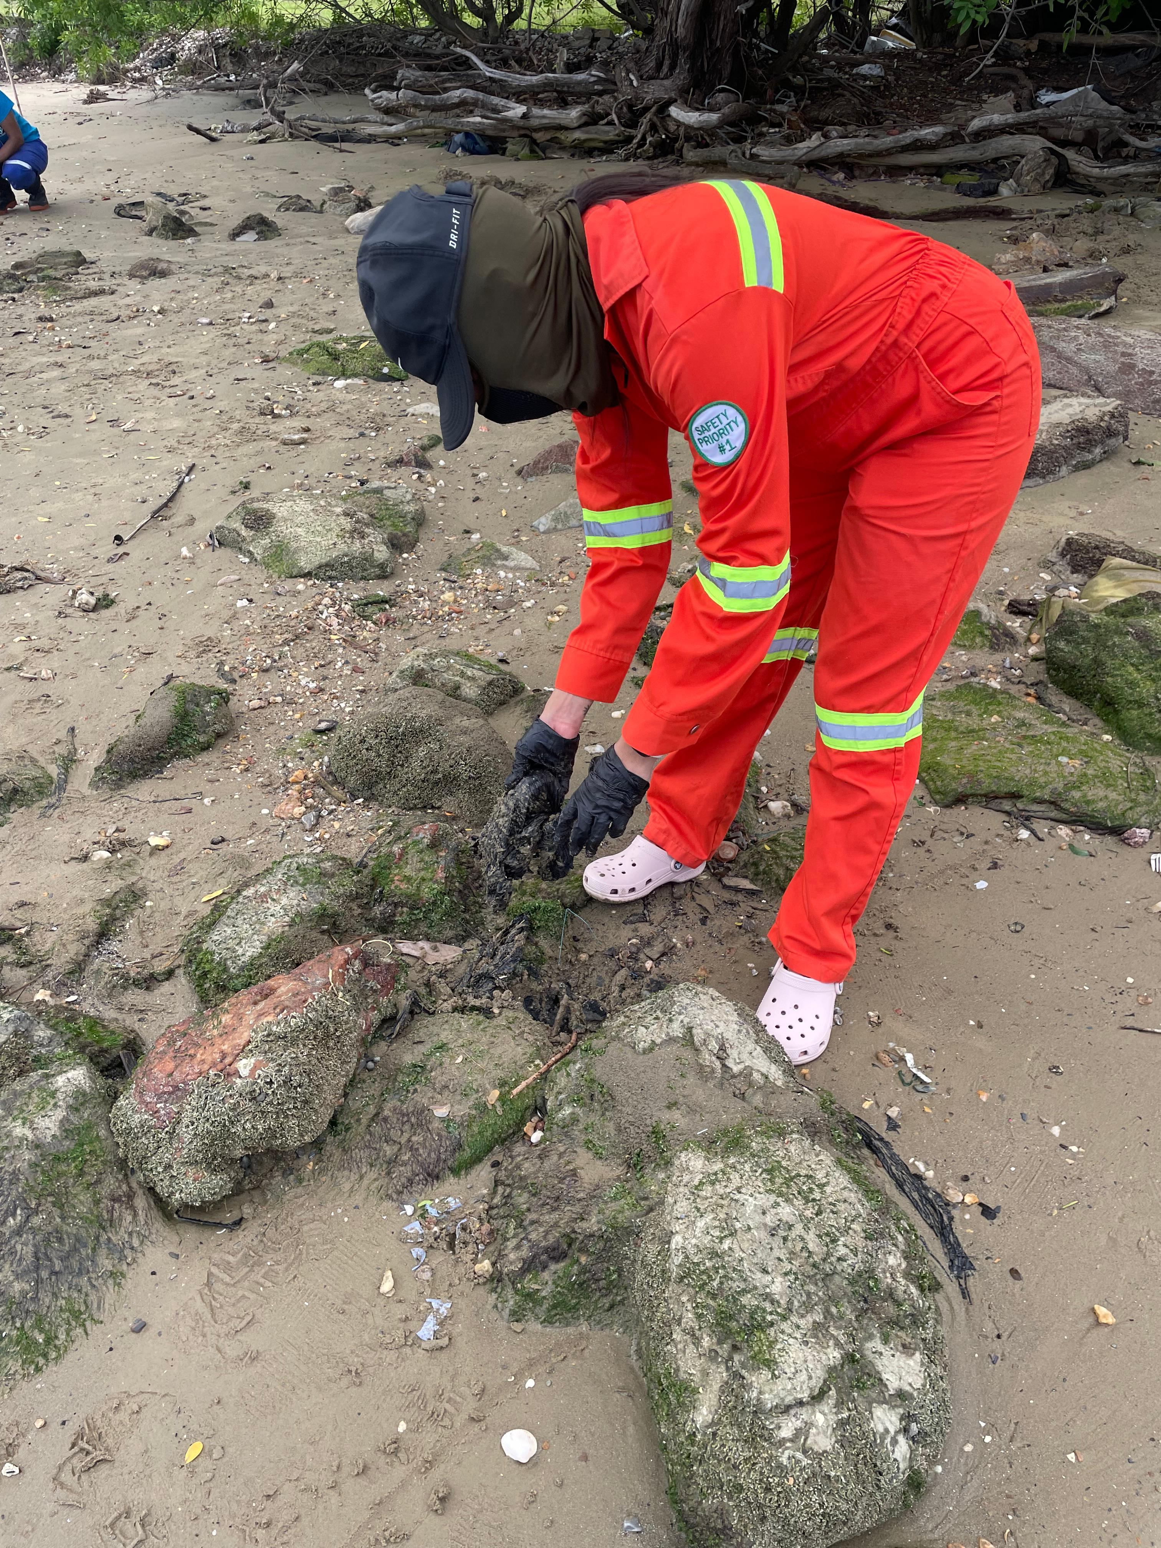
Summary of High Level Highlights
A Region United:
  Accession of St. Kitts & Nevis to LBS & SPAW Protocols
Strategic Foundation
  Developed and/or operationalized key strategies: Draft Medium-Term Strategy, Resource Mobilization, Knowledge Management & Communications, & updated RAC/RAN Guidelines
  Tangible Impact
  Projects on wastewater (GEF CReW+), plastics (GEF LAC Cities, PROMAR), biodiversity (GEF Gulf of Mexico LME, UNDP GEF PROCARIBE+), & Governance (EU ACP MEA III).
Elevated Influence
  Vice-Chair of Caribbean Ocean Coordination Mechanism (OCM) Executive Group; new partnerships with International Whaling Commission (IWC) & Inter-American Convention for Sea Turtles (IAC); Sargassum.
Enhanced Visibility
  Grew our digital presence by 112% on LinkedIn & secured major media coverage, amplifying the Wider Caribbean's voice.

Slide 4
Status of Responses to SPAW COP 12 Decisions
Decision |  | Summary of Implementation | Status
I | Workplan and Budget | Fully adopted & implemented with priority activities and strengthened synergies with regional partners.
II | Protected Areas and Species | New protected areas & species listings approved; species-specific recommendations advanced; cooperation among working groups fostered.
III | Adoption of Documents | Strategic Plan 2023-2028 and Marine Mammal Action Plan adopted.
IV | Ratification | Targeted outreach led to increased engagement and the ratification of SPAW and LBS by St. Kitts & Nevis.
V | Working Groups | Participation encouraged; assessment conducted; inter-subprogramme integration improved (with LBS-OEWG).
VI | Coordination and Management | SPAW Consortium operational with regular meetings & inputs to Workplan.
VII | Governance | Expanded Bureau created; improved outreach to all Contracting Parties.
VIII | Sargassum | Regional collaboration enhanced, including joint WG meetings and updated Action Plan; SPAW side event held at SIDS4, side events at UNOC 3 with SPAW RAC
In Progress
Achieved

Slide 5
Status of Responses to LBS COP 6 Decisions
Decision | Status
Work Plan and Budget - Integration of the AMEP & SPAW sub-programmes on Nutrient pollution, Sargassum and Marine Biodiversity; Collaboration between the LBS & SPAW Regional Activity Centres (RACs).
Nutrients and Wastewater - Report on status of progress to the LBS STAC7 and LBS COP7 for way forward.
State of Convention Area Report on Marine Pollution – Begin development of this report including proposal for a more integrated assessment report. (ongoing)
Monitoring & Assessment – Enhanced cooperation with INVEMAR, IAEA and the REMARCO Network
LBS Protocol Ratification – Support countries in national ratification processes. (ongoing)
Partnerships – Increase collaboration & cooperation with other Regional Seas. (ongoing)
Knowledge Management, Data and Information – Improve dissemination of knowledge management products (ongoing)
In Progress
Achieved

Slide 6
Status of Responses to COP 18 Decisions
Decision | Status
1. Work Plan and Budget - Mobilize Resources for unfunded projects.
III. RAC REMPEITC Caribe - Raise awareness and promote expansion of the COSTA Programme - Sign new MOUs
IV. Regional Strategy - Establish Working Group, Incorporate Comments, present for Intersessional Approval
V. Governance - Updated RAC RAN Guidelines & Working Group Recommendations
VI. Focal Points -Focal Point Toolbox Developed and posted on Website; Updated Focal Point List
VII Ratification -Promote and engage countries for ratification of the Convention and its Protocols. (ongoing)
VIII Ocean Coordination Mechanism - Obtain no-objection for supporting Procaribe+ activities - Facilitate signing of OCM MOU by UNEP
IX Sargassum -Action Plan; Coordination with Abidjan Convention; Raising Visibility; UNEA Resolution
XI Data & Information Management -Regional Platforms - IWEco & Promar (ongoing)
XII Collaboration with Global MEAs -SOI of CBD, GBF, CITES, RAMSAR, Sharing of focal points (ongoing)
In Progress
Achieved

Slide 7
Our Governance Foundation
✅ Guidelines for RACs & RANs:
  Updates the 2008 version to clarify roles & enhance support to Parties.
  To be presented to COP 18 for consideration.
✅ Enhanced Engagement Tools:
  An "Onboarding/Welcome Kit" for new Focal Points
  Relaunched Secretariat Newsletter
  Online Reporting - collaboration with Barcelona Convention/Info RAC
  Regular engagement with Bureau & Focal Points
✅ Draft Cartagena Convention Medium-Term Strategy (2023-2030):
  Finalized through Open-Ended Working Group of Parties.
  Provides a strategic roadmap.
✅ First Resource Mobilization Strategy (2024-2028):
  Direct response to long-standing financial constraints.
  Proactive plan to diversify funding & enable greater sustainability.

Slide 8
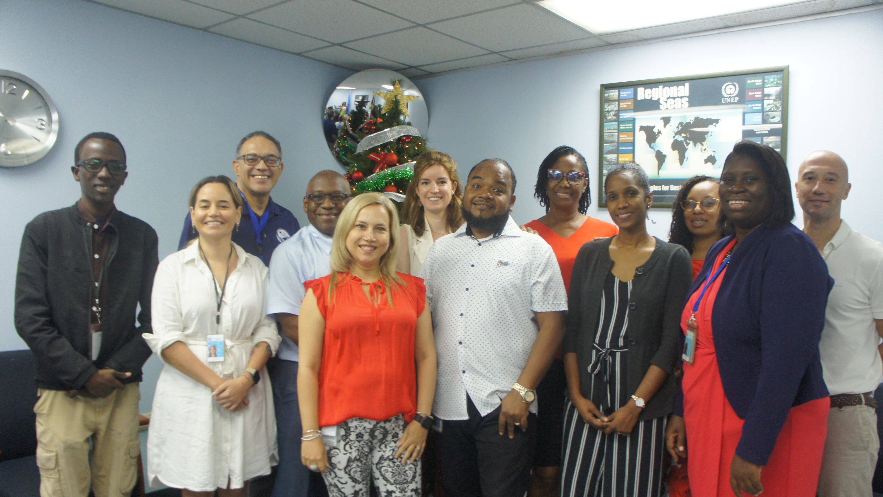
Part 2:
Our Operational Engine

Slide 9
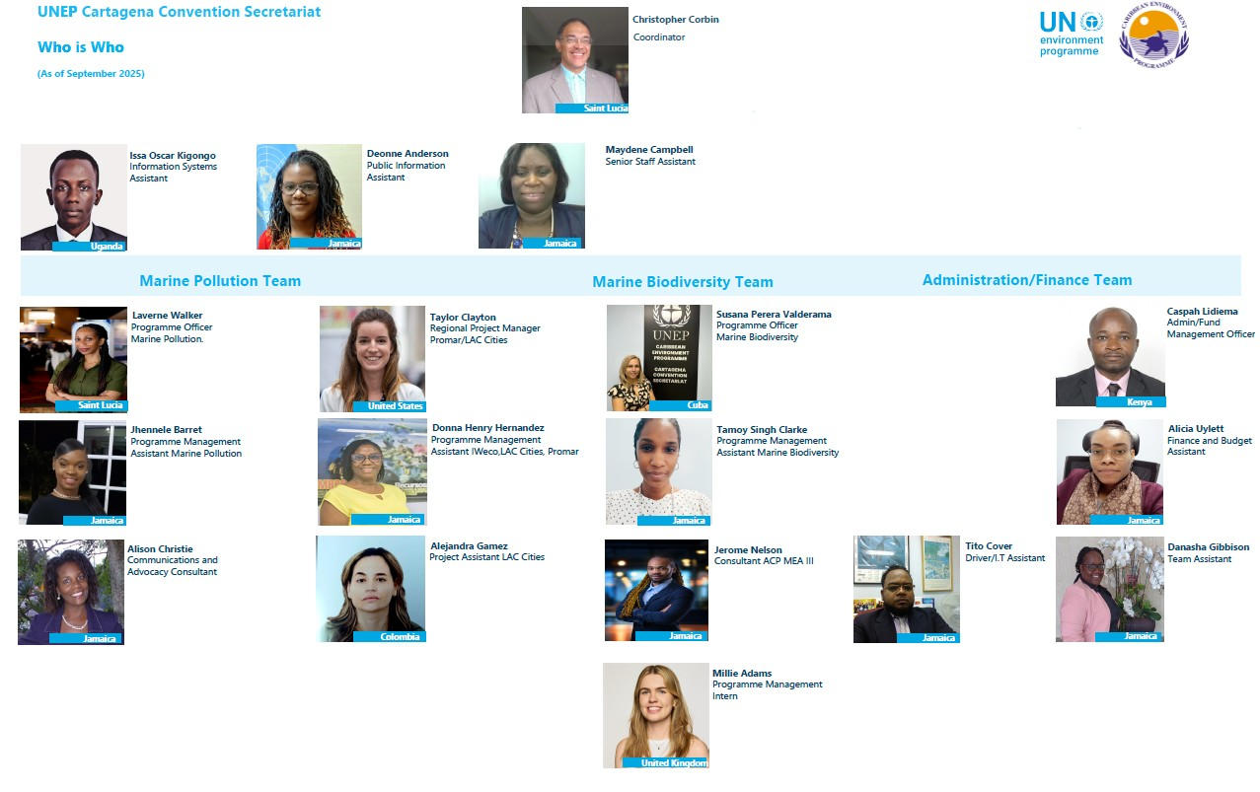

Slide 10
Collective Financial Commitment for a Sustainable Future
Contributions RECEIVED – 10th October 2025
*Payment from Government of Guatemala

Slide 11
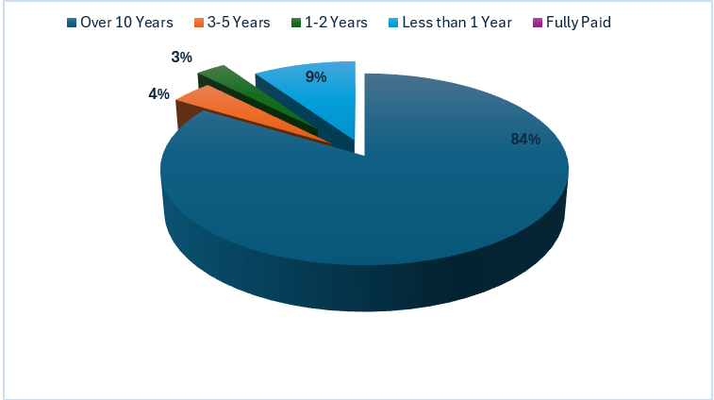
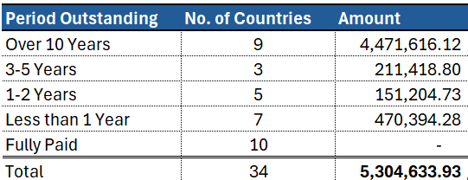
Outstanding PAYMENTS

Slide 12
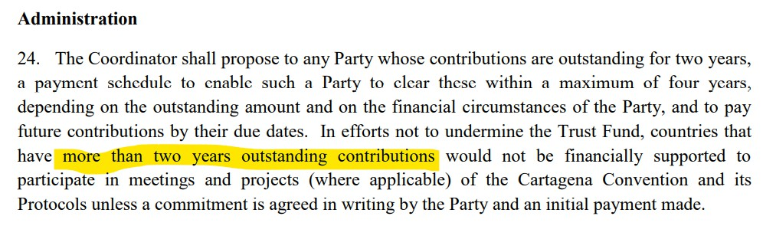
Financial rules – Cartagena convention
Notes:
1.Invoke Article 24 of the Cartagena convention Financial rules on Administration

Slide 13
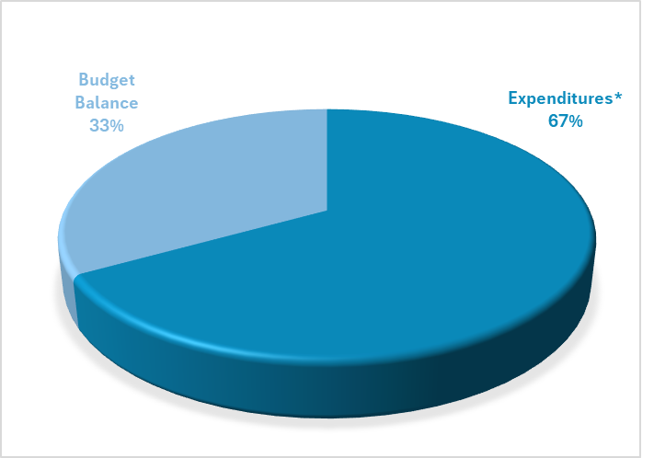
BUDGET PERFORMANCE (USD)

Slide 14
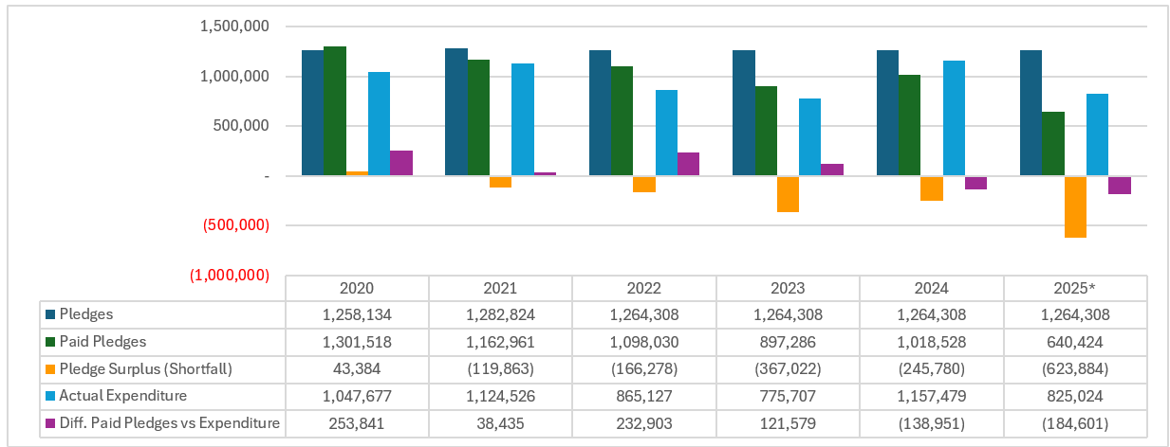
MANAGING THE CTF FUNDING GAP
Notes:
While Expenditures have remains within the contributions, a large portion of operational costs have been supported by projects
There is need to analyze the most sustainable approach for the Secretariat to effectively deliver its functions within the current level of contributions to the Trust Fund

Slide 15
From Pledges to Progress: Ensuring Accountability & a Sustainable Financial Future
The Lifeline: Caribbean Trust Fund (CTF): Primary source of core operational funding.
Pledges vs. Reality:
  Total Biennial Pledge (2023-2024): USD 2,528,616
  Total Received (2023-2024): USD 1,915,814 (~76% of pledge)
  2025 Receipts (as of August 31): USD 640,424.
Persistent Challenge:
  Outstanding contributions have accumulated, impacting planning & programme continuity.
Strategic Response:
  Programme Support Costs (PSC) from projects has helped to co-fund core administrative posts.
  Implemented strict cost-saving measures.
  The new Resource Mobilization Strategy is our proactive path forward but requires Parties Commitment.

Slide 16

Part 3:
Our Impact on the Ground & Sea
Turning the Tide on Pollution:
Cleaner Lands for a Healthier Ocean

Slide 17

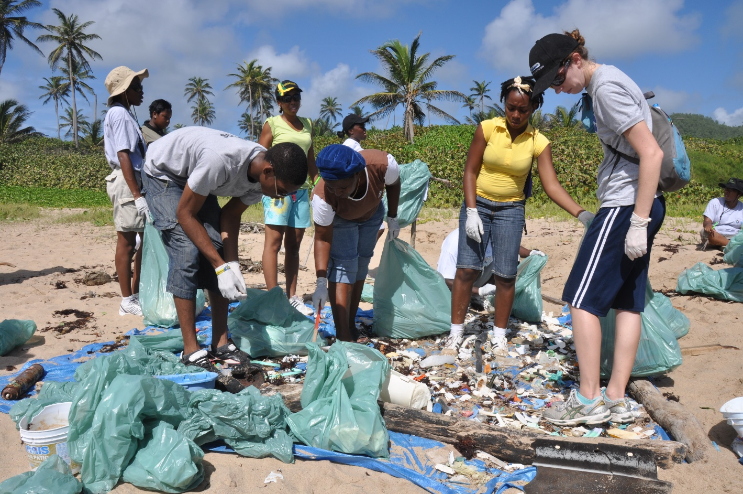
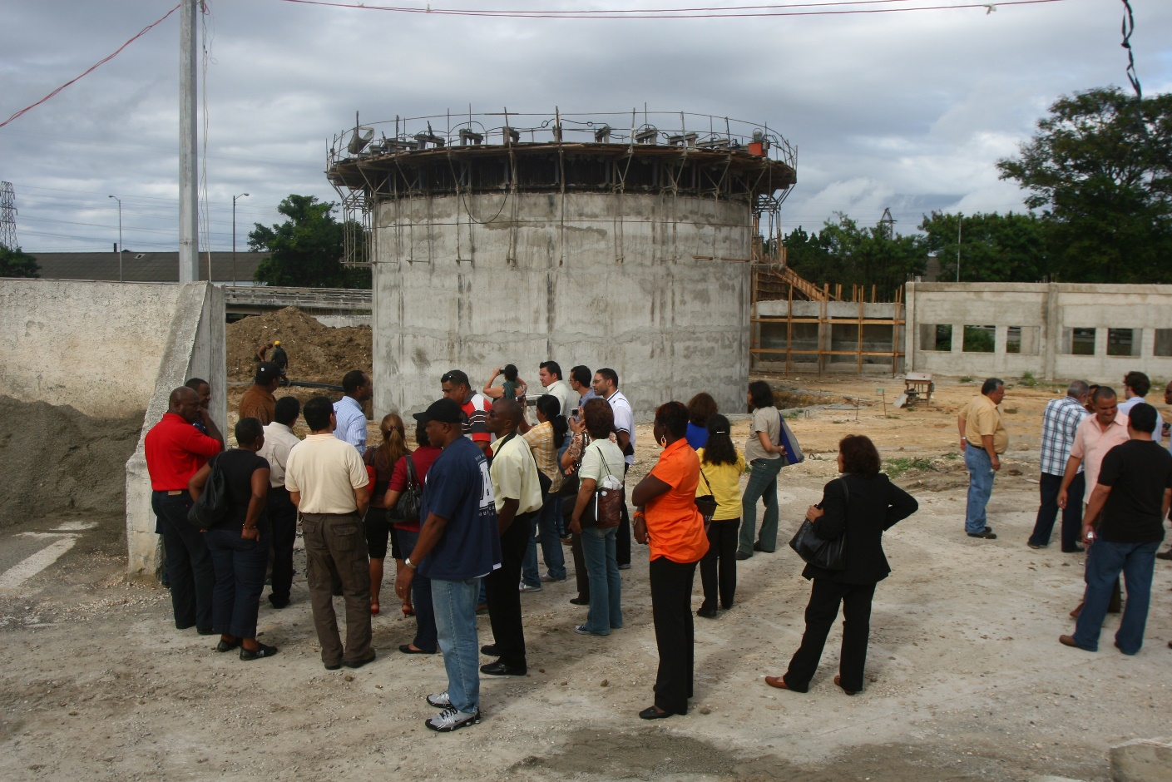
THEMATIC APPROACH TO AMEP WORK PROGRAMME IMPLEMENTATION
Programme Coordination & Management
Land & Marine Based Sources of Pollution
Monitoring & Integrated Ecosystem Assessment
Ecosystem Based Management Approaches

Slide 18
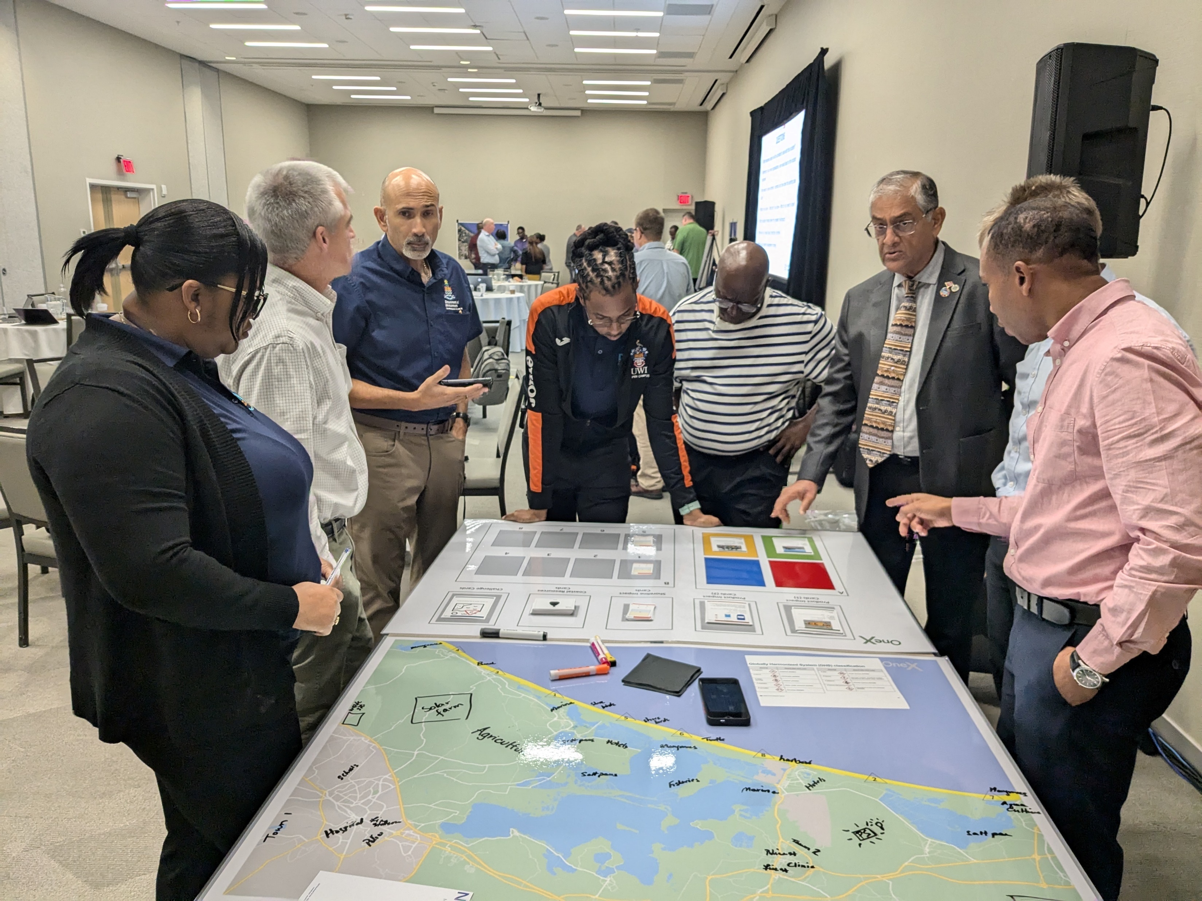
Oil Spills Protocol
Sustaining Response Capacity: Continued promotion of the COSTA programme for oil spill monitoring in the Eastern and Southern Caribbean.
Navigating Transition: Ongoing discussions with IMO, Governments and partners, regarding the future hosting and operations of RAC REMPEITC-Caribe.
Maintaining Vigilance: The Secretariat continues to facilitate dialogue to ensure regional readiness remains a priority.
Directors and Heads of Maritime Administrations (DIHMAR) Caribbean participation in Saint Lucia in 2025
Secretariat participation at the UK Overseas Territories Counter Pollution Workshop in Miami in 2024

Slide 19

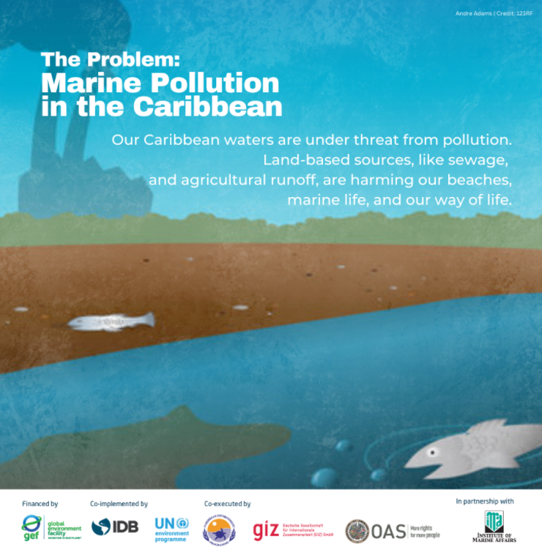
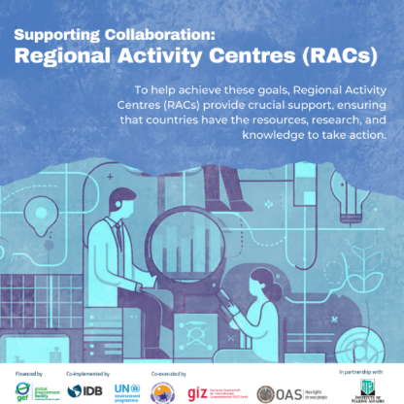

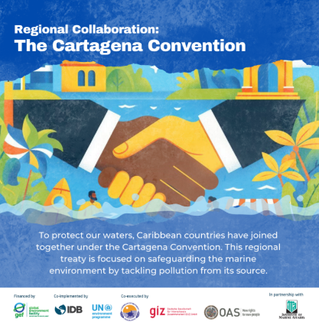
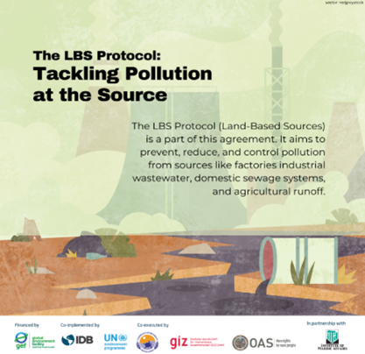
LBS PROTOCOL RATIFICATION
The Government of St. Kitts & Nevis became the 16 Contracting Party to the LBS Protocol in October 2024
LBS RACs supported the Secretariat in promoting LBS Ratification through:
  Developing promotional material
  Convening workshops in Cuba and St. Vincent and the Grenadines on the benefits of becoming a Party

Slide 20
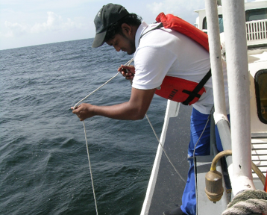
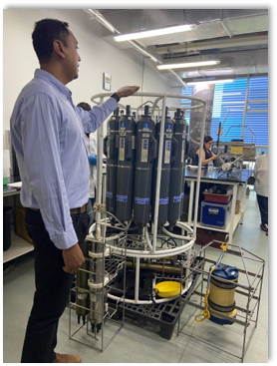
Support to the Open-Ended Working Group on Monitoring and Assesment
New Thematic Sub-groups under OEWG established
New experts nominated to the Working Group and the Subgroup
Meetings of OEWG & thematic subgroup convened virtually
Co-leads of the thematic subgroup identified
Joint OEWG & Sargassum Working Group Meeting
Reviewed & revised TORs of Working Group
Reviewed technical papers developed by RACs & presented to LBS STAC 7 for consideration
Notes:
These included a slight change to the scope to providing technical guidance on documents and products requested by the STAC and providing guidance on programmes related to integration between SPAW and AMEP programmes. Experts can be nominated to join the Working Group and subgroups by CPs and the Secretariat. STAC is also being requested to submit the revised OEWG TOR to the 7 LBS COP for their endorsement.

Slide 21




TECHNICAL SUPPORT TO
IMPLEMENT OIL SPILLS AND LBS PROTOCOLS
Support provided to Dominican Republic to develop draft MARPOL Regulations & Barbados to update a National Oil Spills Contingency Plan and Dispersant Use Policy – supported through ACP MEA III
Partnered with CAWASA to provide training for certification of wastewater operators in Wastewater Treatment and Wastewater Collection – GEF CReW+
Partnered with CWWA and IMA to host online workshop on wastewater reuse – GEF CReW+
Partnered with RARE to develop behavior-centered design processes to reduce pollutants & the Global Water Partnership – Caribbean engaged with youth and journalist focusing on wastewater management and innovative reuse technologies.
Notes:
Caribbean Water & Sewerage Association Inc (CAWASA)

Slide 22
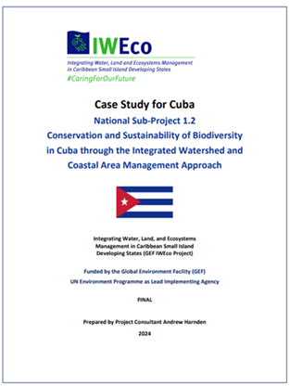
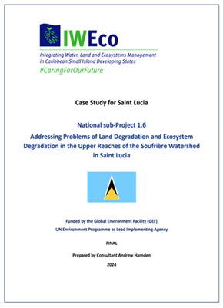
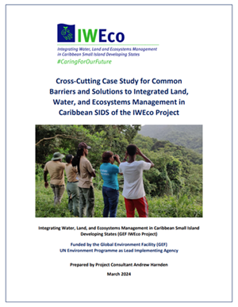
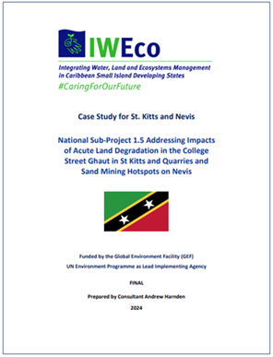
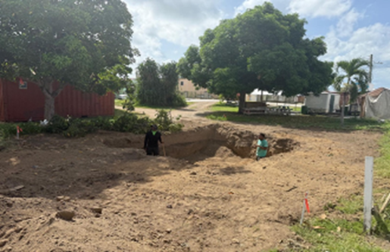
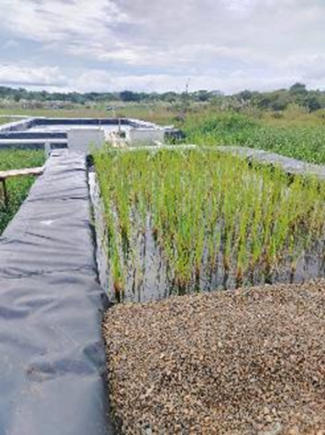
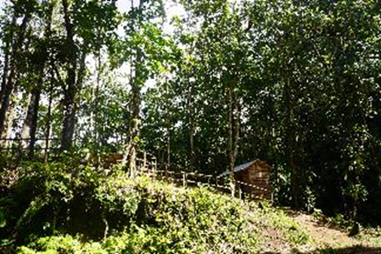


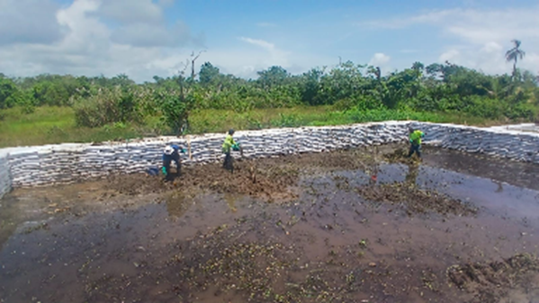

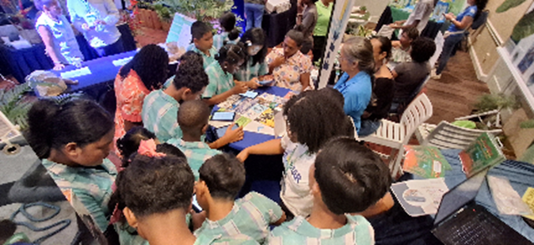




Addressing Land Based Sources of Pollution
Sustainable Livelihoods Saint Lucia
Clean up activity Guyana
Green awareness expo Suriname

Slide 23
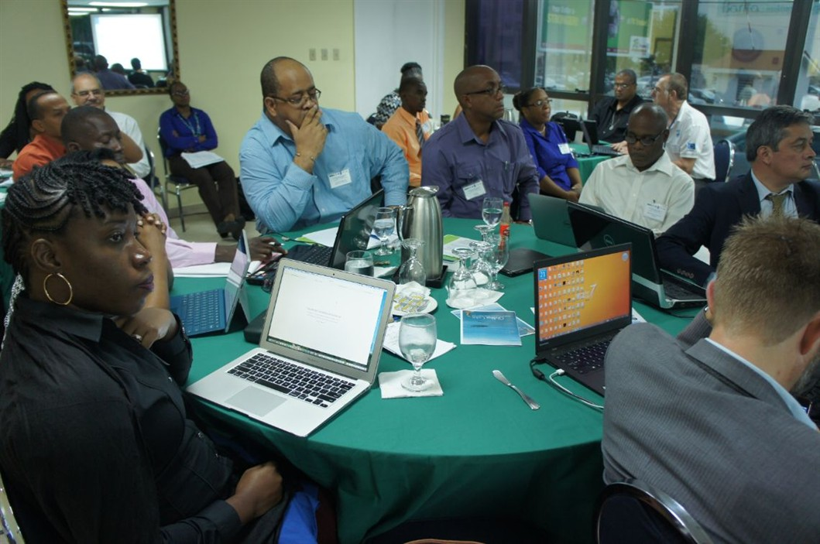
EXPANSION OF THE REGIONAL ENVIRONMENTAL MONITORING PLATFORMS
REMDAP developed with support of IWEco Project launched in March 2024 with the OECS
Regional platform for information and monitoring related to marine litter currently under development under PROMAR project with GRID Geneva.
National Water Information Management Systems (WIMS) advanced in four CReW+ countries by the United Nations University Institute for Water, Environment and Health (UNU INWEH) to facilitate access to and the dissemination of water-related data
Notes:
REMDAP developed with support of IWEco Project launched in March 2024
Serves as a clearinghouse mechanism and decision-making tool to strengthen the process of regional environmental monitoring and assessment within the Caribbean region
National Water Information Management Systems (WIMS) advanced in four CReW+ Project beneficiary countries by the United Nations University Institute for Water, Environment and Health (UNU INWEH) to facilitate access to and the dissemination of water-related data
Improve national capacities to analyze and manage spatial water-related data

Slide 24
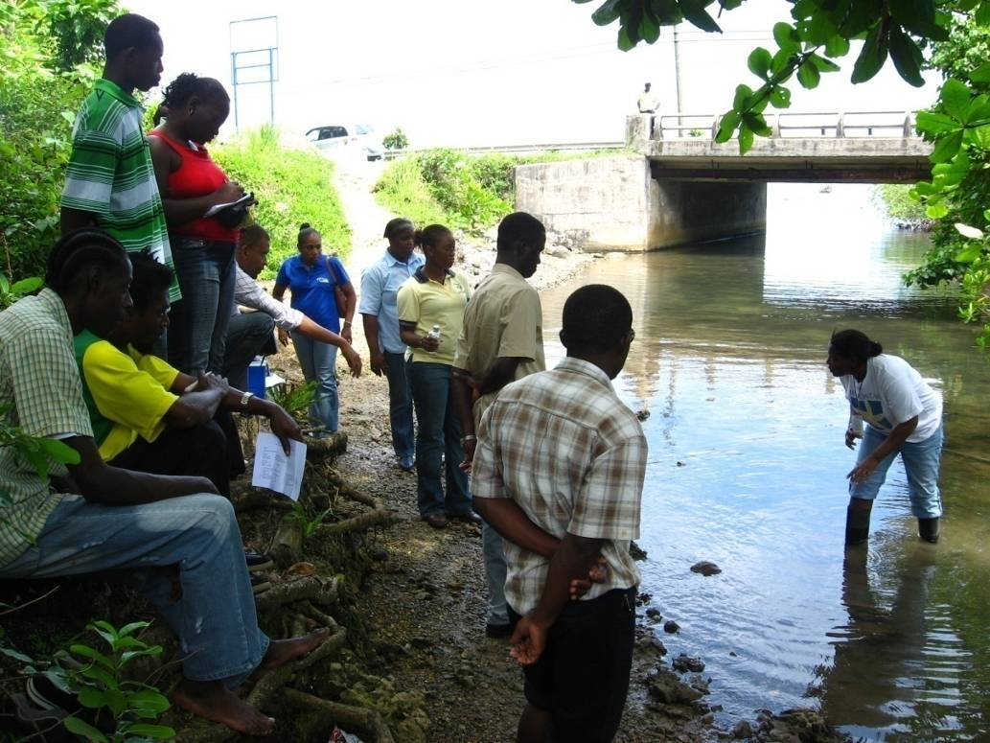
COASTAL WATER QUALITY MONITORING PROGRAMMES
Through the US EPA Water Quality Capacity Development Project and UNEP’s Source to Sea Pollution Unit, the Secretariat administered a survey to:
  Assess the specific needs to address capacity gaps and challenges in water quality monitoring and management
Through the Support For Enhancement of National Water Quality in the Wider Caribbean Region funded under the United Kingdom’s Sustainable Blue Economy Technical Assistance Programme with technical support of Cefas
Supporting Guyana and Jamaica to strengthen national water quality monitoring capacity

Slide 25
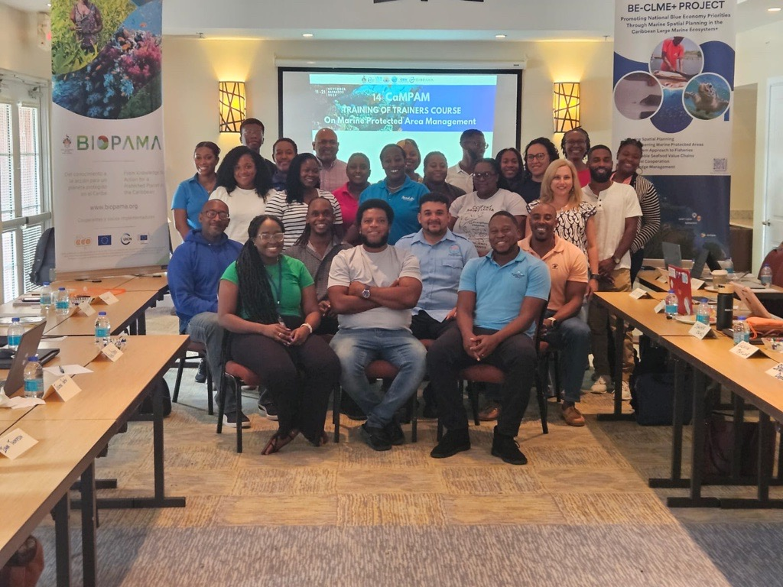
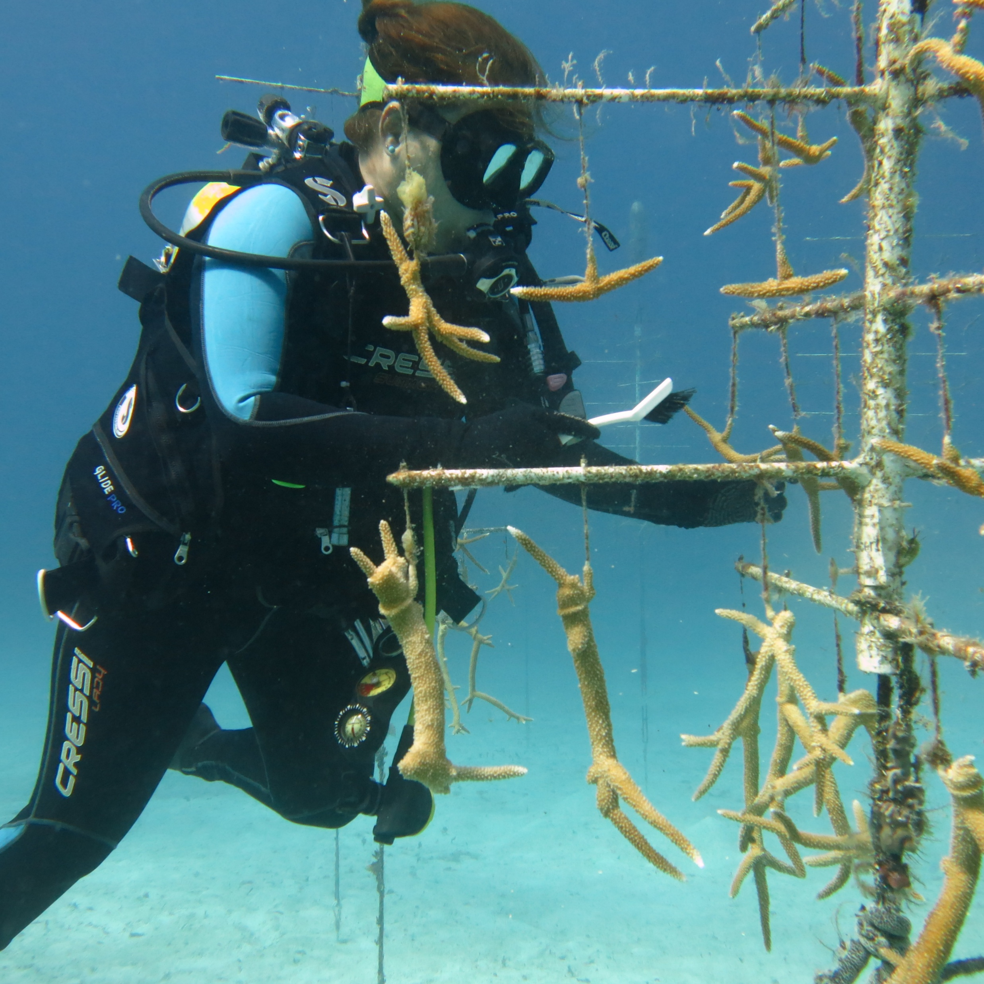
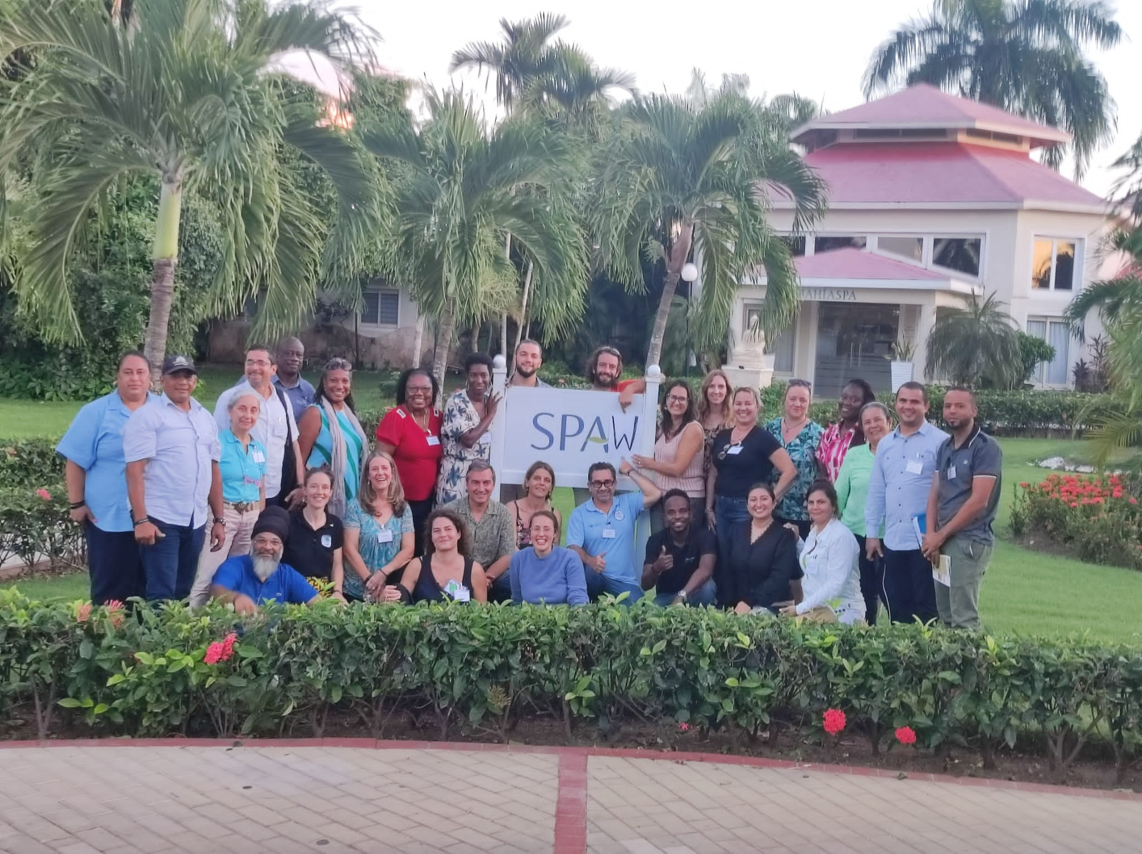

Marine Protected Areas (MPAs) Management – ACP MEA III
Developing a functional network of SPAW-listed Protected Areas (PAs) (subject to COP adoption).
Strengthening capacity for regional biodiversity management & coordination through CaMPAM activities (ToT 14th Edition).
Supporting national actions to meet SPAW obligations through training and outreach, SPAW-RAC small grants programme & joint CaMPAM-GCFI-GPML joint small grants.

Slide 26
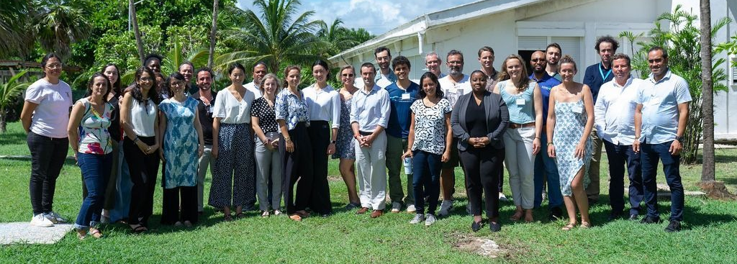
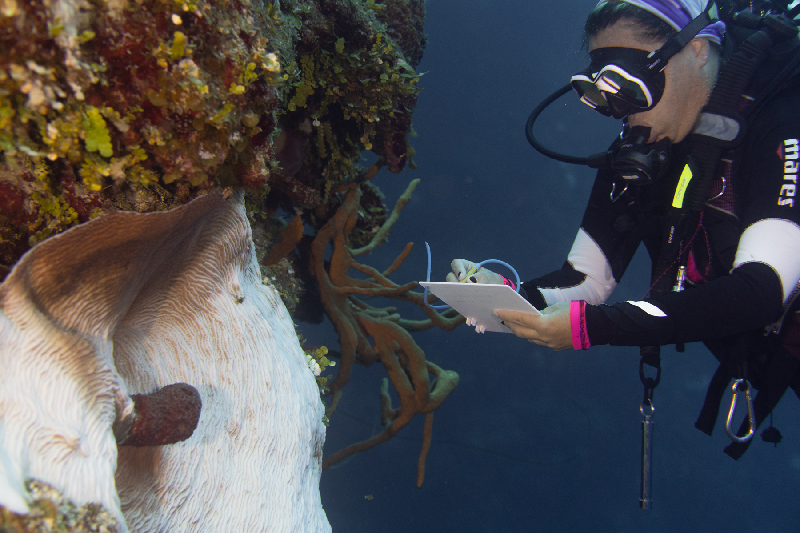
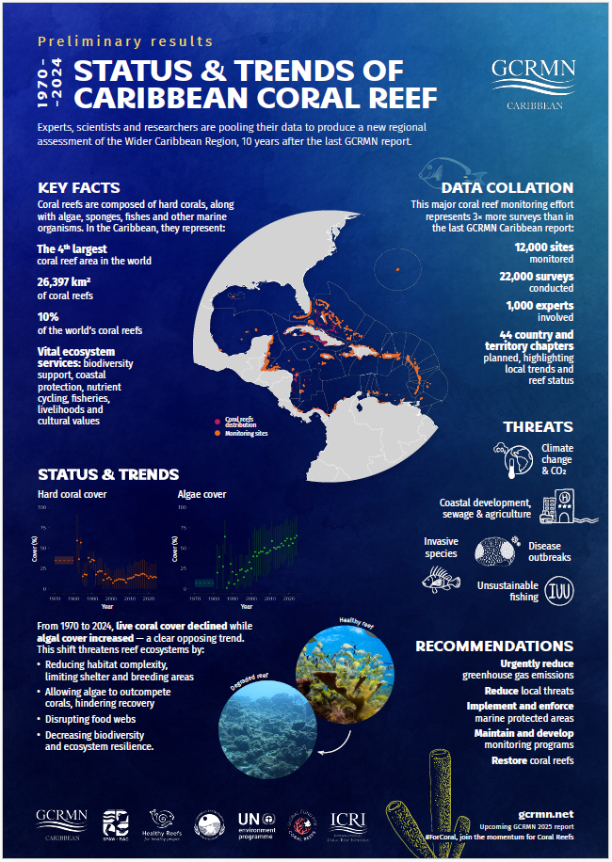
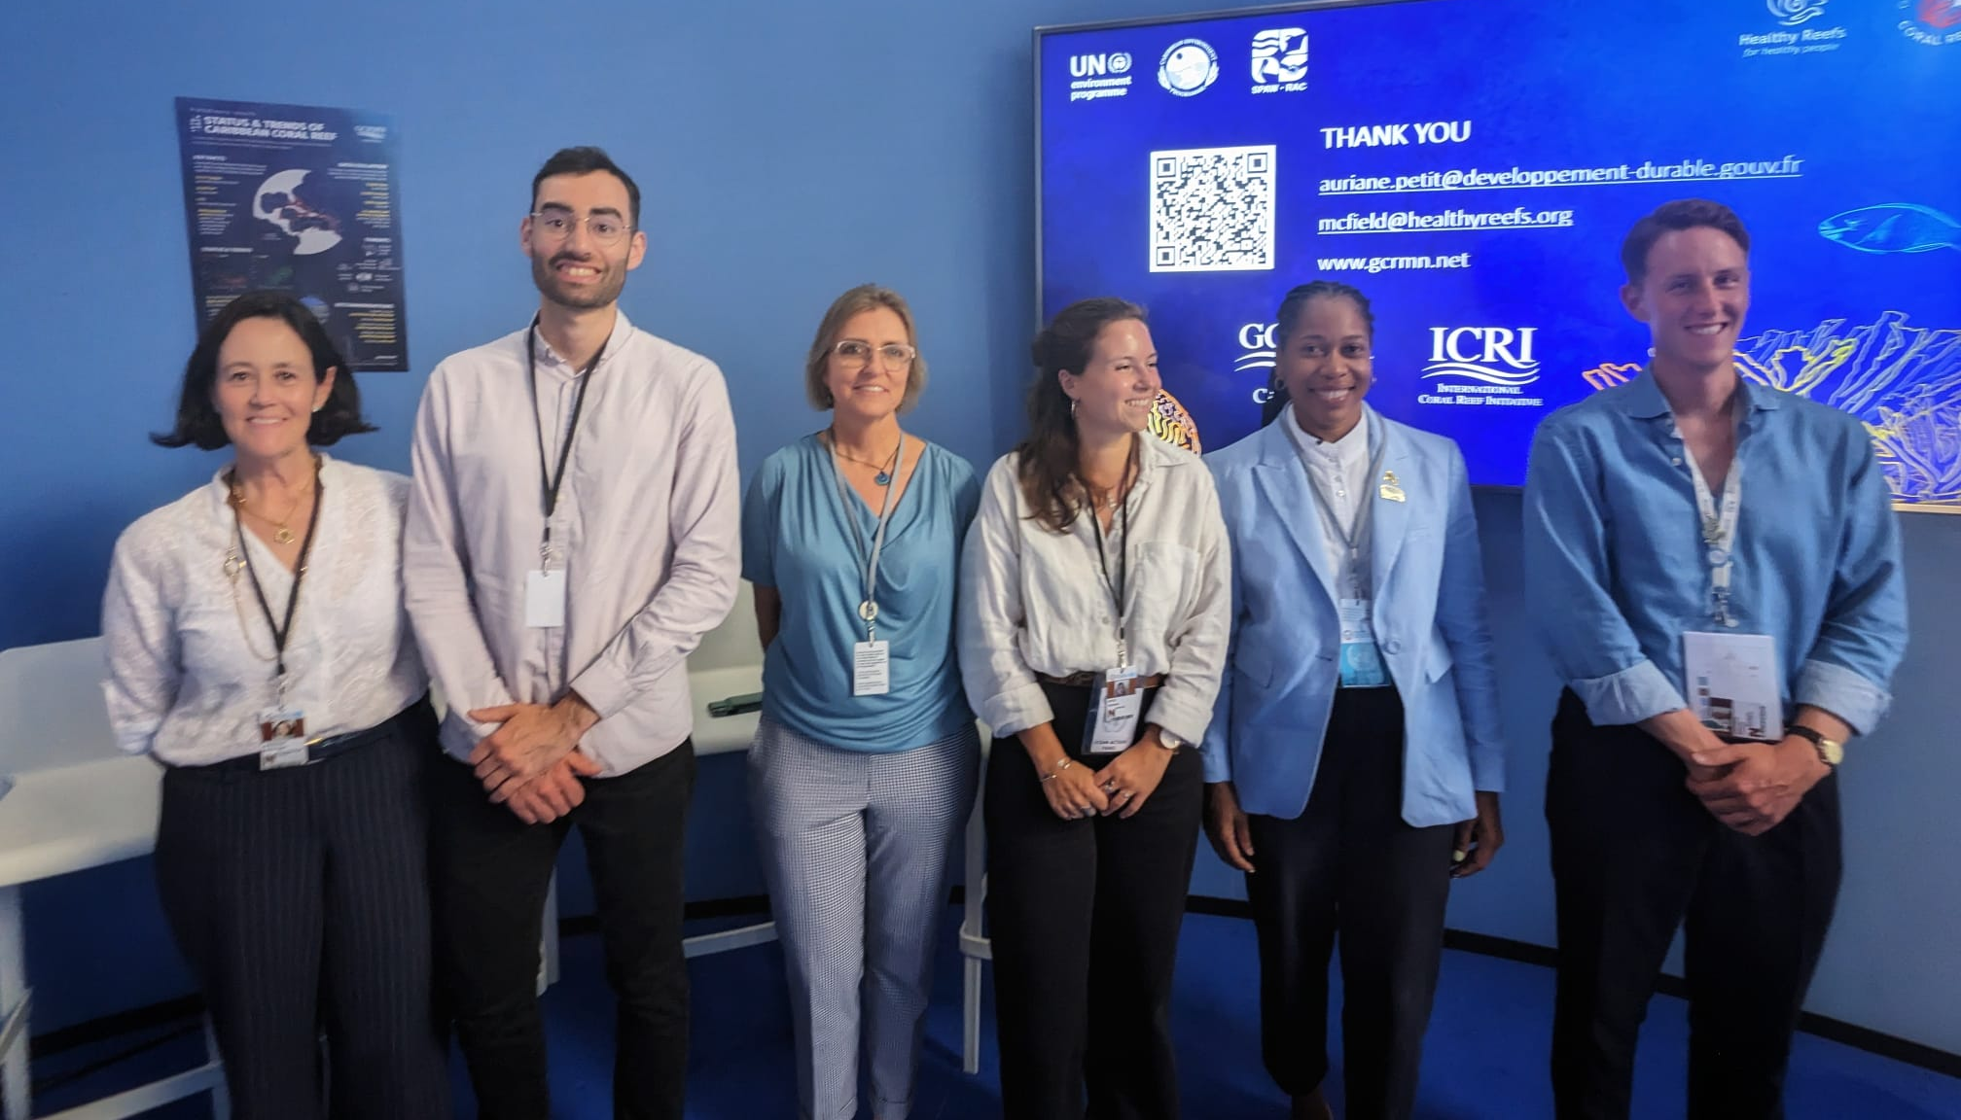






MPAs, Ecosystem Based Management & Habitat Restoration:
GEF Gulf of Mexico LME AND PROCARIBE+ projects
Collaboration with SPAW-RAC, CONABIO, Kalanbio, Reef Check Dominican Republic.
Harmonizing coral reef monitoring & management approaches across subregions.
Strengthened regional capacity-building on MPAs, OECMs, EBM through training (ToT 14th and 15th Edition), peer exchanges, & technical cooperation.

Slide 27
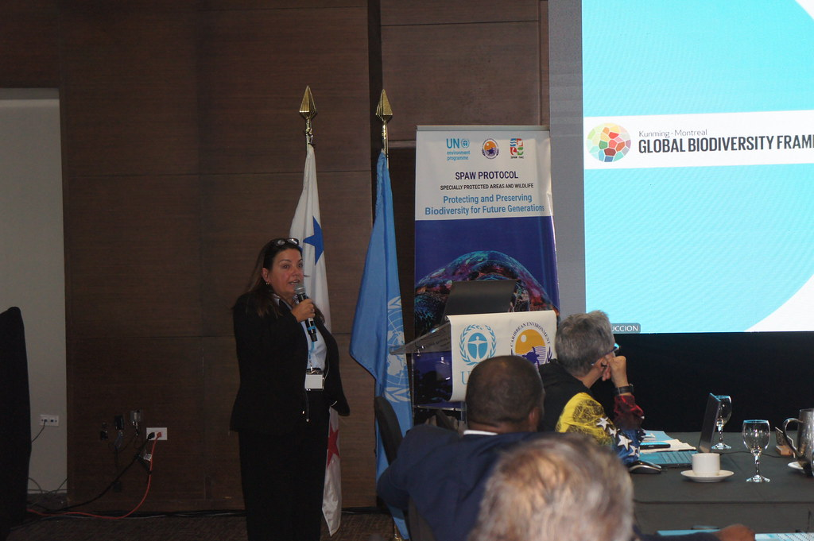
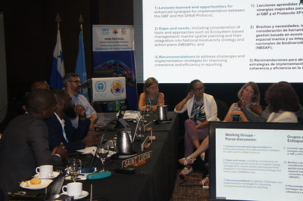
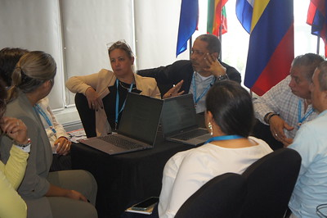


Strategic Partnerships
Signed Letters of Intent with International Whaling Commission (IWC) & Inter-American Convention for the Protection of Sea Turtles (IAC).
Contracting Parties supported in implementing the SPAW Protocol and the Global Biodiversity Framework (GBF) in an integrated manner, with support from UNEP’s Marine and Freshwater Branch (MFB) and Biodiversity and Land Degradation Branch (BLB).
Strengthened the collaboration with the SPAW Consortium as a platform for civil society engagement.

Slide 28

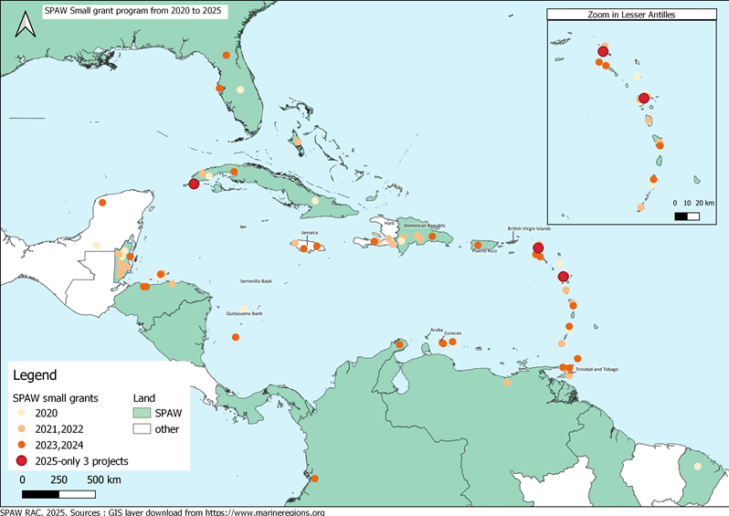
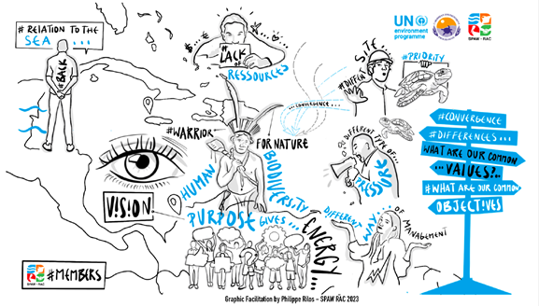
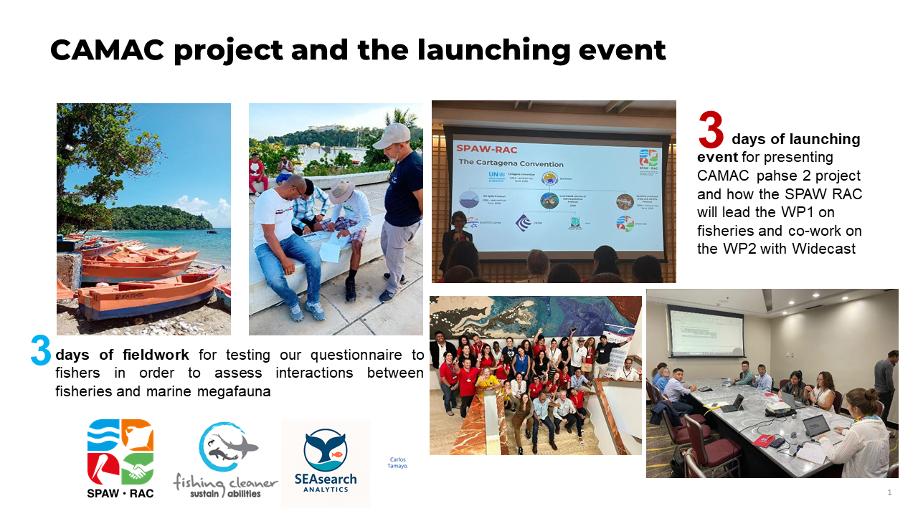

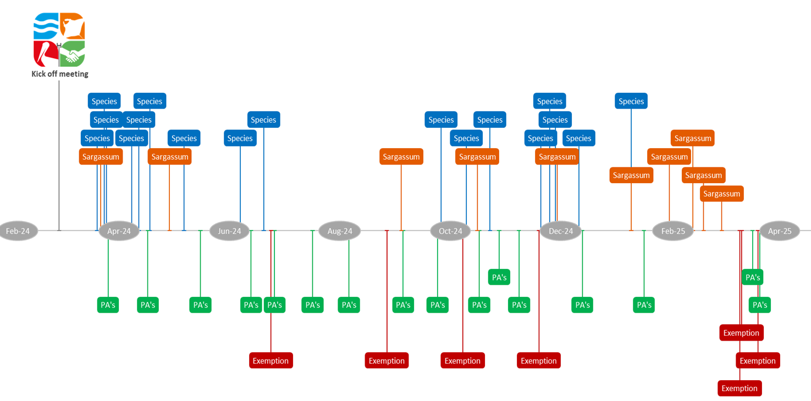
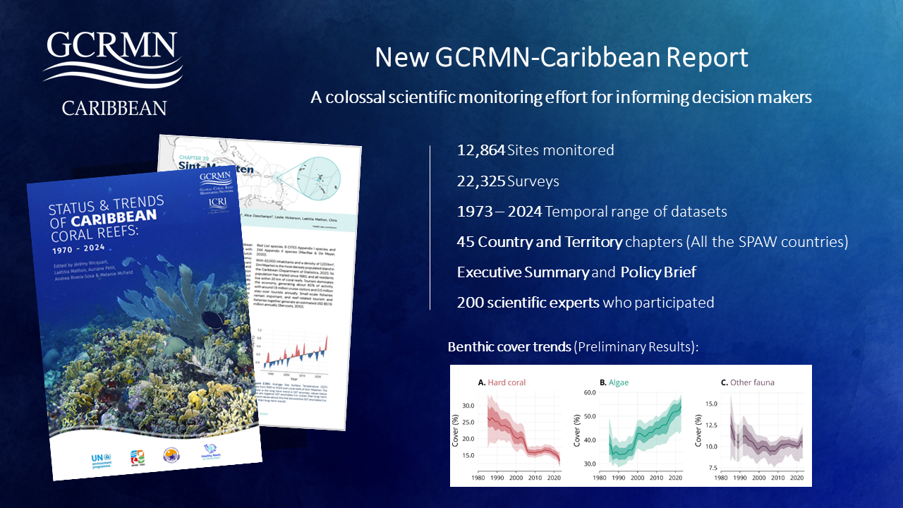
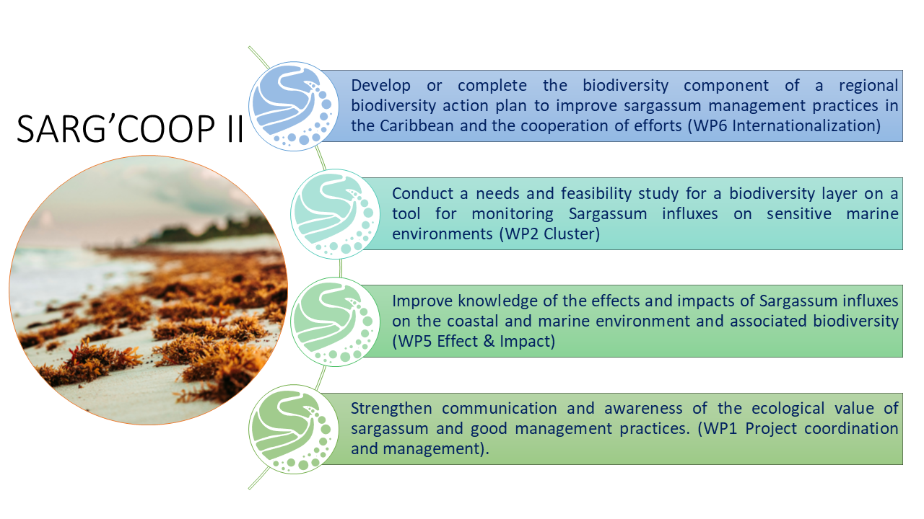
SPAW-RAC Key Role in SPAW protocol implementation
Implementation of small grants programme supporting national implementation of the SPAW protocol
Development of the support programme for SPAW-listed MPAs to enhance management effectiveness & regional cooperation.
The recently launched CAMAC Project, with pilot sites selected to assist Contracting Parties in addressing bycatch of marine megafauna.
The recently launched SARG’COOP2 Project, to improve the knowledge on the impacts of Sargassum on biodiversity and its effects on nearshore and coastal ecosystems.
SPAW-RAC chairs SPAW’s ad hoc working groups : sargassum, species, protected areas and exemptions
The lead of the GCRMN Caribbean report with 200 experts et 12,864 sites monitored
Notes:
SPAW-RAC plays a key role in technical coordination, data management, and capacity building, including through:

Slide 29


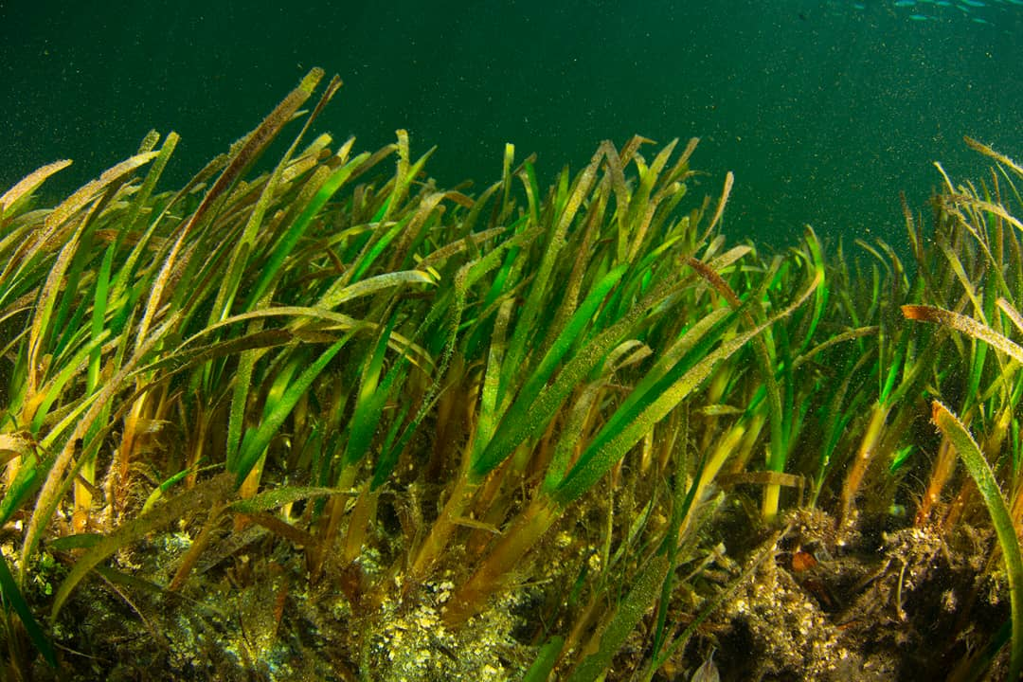

Future Initiatives
Developed the SBE Seagrass Restoration Project in collaboration with JNCC to promote ecosystem restoration.
Preparation of GEF project proposal for submission to the Global Biodiversity Framework Fund (GBFF).
  An initial proposal was prepared for submission to the September Call for Proposals of the GBFF (targeting SIDS), though it did not advance due to limited expression of interest from potential partners (countries).

Slide 30
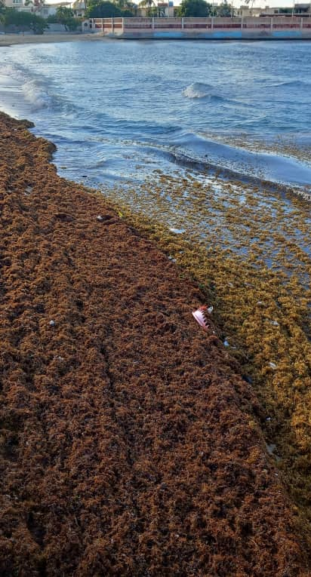
From Crisis to Opportunity:
A United Secretariat & Wider Caribbean Approach to Sargassum Management
A "One Convention" Approach:
  Participation of LBS and Cartagena Convention experts in the SPAW Sargassum Working Group.
  Convened joint meeting of the SPAW Sargassum WG and the AMEP Monitoring OEWG (March 2025, Trinidad and Tobago).
Advanced the draft Regional Sargassum Action Plan.
Regional & Global Leadership:
  Engaged with the Abidjan Convention to address the transboundary nature of the crisis.
  Showcased the issue & the regional response at UNOC 2025 and SIDS meeting in Antigua and Barbuda.
  Draft Action Plan will be presented at COP 18 for possible adoption.

Slide 31
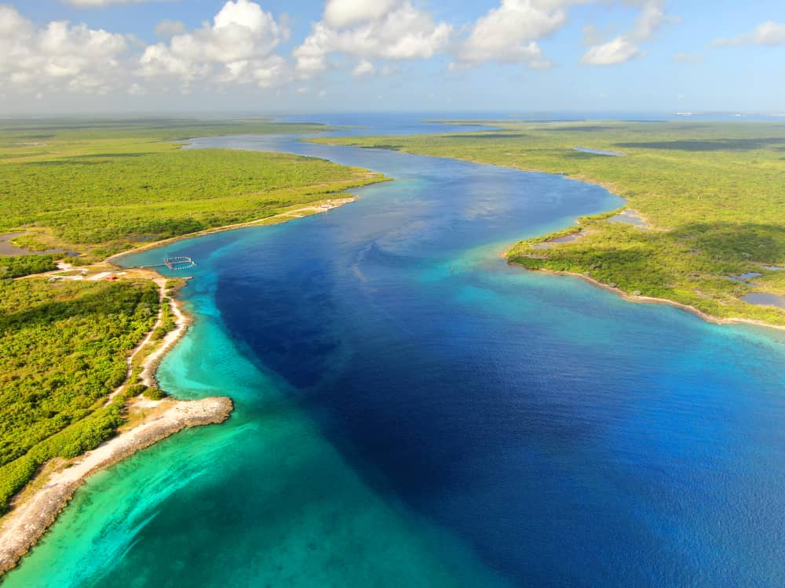
Part 4:
Amplifying Our Work &
The Way Forward

Slide 32
Knowledge Management & Communications
Strategy in Action:
Implemented a new Knowledge Management & Communications Strategy as core advocacy tool.
Maintained active social media presence across Instagram, Facebook, LinkedIn, and X, with increased engagement and visibility for our work in the region.
Produced cross-platform content aligned with UNEP themes and regional priorities, improving recognition of the work of the Cartagena Convention and its Parties.
Digital Growth & Reach:
LinkedIn followers grew 112% to 3,186.
Total social media following maintained and engaged across Facebook, X (Twitter), & Instagram.

Slide 33
Knowledge Management & Strategic Communications cont.
Key Products & Platforms:
Relaunched the Secretariat's Newsletter.
Published the "Guide for Pollution Assessment & Monitoring" and other technical briefs.
Secured 5 press releases and 25+ media publications, including prime-time TV and radio interviews.
Stakeholder Engagement:
Actively commemorated global environmental days and developed targeted campaigns.
Major Campaigns & Thematic Content
World Environment Day (June 2025) and World Oceans Day (June 2025): Designed and managed regional campaigns featuring short videos with Christopher Corbin, highlighting regional cooperation, pollution reduction, and sustainable ocean management.
Marine Litter and MPA Awareness (May 2025): Promoted regional grant projects supporting pollution reduction and improved marine protected area management.
SPAW Protocol 25th Anniversary (May–June 2025): Delivered a month-long cross-platform campaign under the theme “25 Years of Protection, A Lifetime of Impact”, including countdown posts, polls, testimonials, and milestone features.

Slide 34
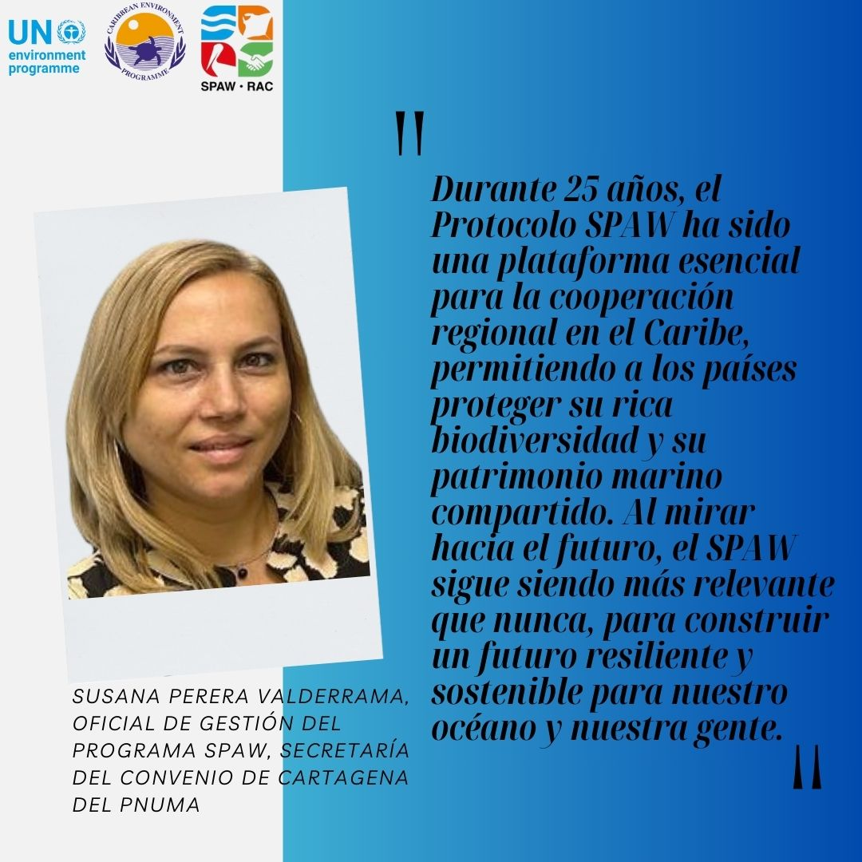





Slide 35


Forging a Cohesive Regional Front
Central Role in Ocean Governance:
UNEP signed the MOU on behalf of the Secretariat for establishing Ocean Coordination Mechanism (OCM) (Vice Chair of Executive Group)
Advocacy on the Global Stage:
SIDS4 (Antigua): Shaped the ABAS agenda, ensuring ocean priorities were central.
UNOC 2025 (Nice): Presented the Caribbean's challenges and solutions, including on Sargassum.
Strengthened collaboration with related Global MEAs – co chair Sustainable Ocean Initiative of the CBD.
Advanced an MOU with the International Atomic Energy Agency (IAEA) on plastic pollution.

Slide 36
Challenges
Financial Sustainability:
Outstanding CTF contributions remain the most significant challenge, limiting programme flexibility and core capacity.
Human Resource Capacity:
Despite recent recruitments, the Secretariat's capacity is stretched thin across multiple complex projects and regional demands.
Project Implementation Delays:
Some projects, like GEF CReW+, required extensions due to delays at the national level, highlighting systemic challenges in execution capacity.

Slide 37
The Way Forward/Possible Decision(s)
Adopt/Endorse/Provide a way forward for the updated RAC/RAN Guidelines and the Regional Sargassum Action Plan (to be discussed at LBS COP 7, SPAW COP 13 & CCS COP 18).
Provide guidance on priorities for the 2026-2027 Work Plan and Budget.
Support the Secretariat in fully operationalizing the Resource Mobilization Strategy.
A Call to Collective Action:
Contracting Parties are urged to honor their financial pledges to the CTF to ensure the Secretariat's core operational stability.
Encourage ongoing collaboration between Convention Focal Points & other relevant MEA focal points at the national level and/as appropriate regional level for enhancing synergies.

Slide 38




Thank you
United for a Resilient Caribbean Sea: Strengthening Cooperation, Action, and Impact
Photo courtesy of Noel Lopez & Freepiks
UNEP Cartagena Convention Secretariat and Caribbean Environment Programme
(876) 922-9267-9
unep-cartagenaconvention@un.org
www.unep.org/cep
@unep_cep

